Slide 1
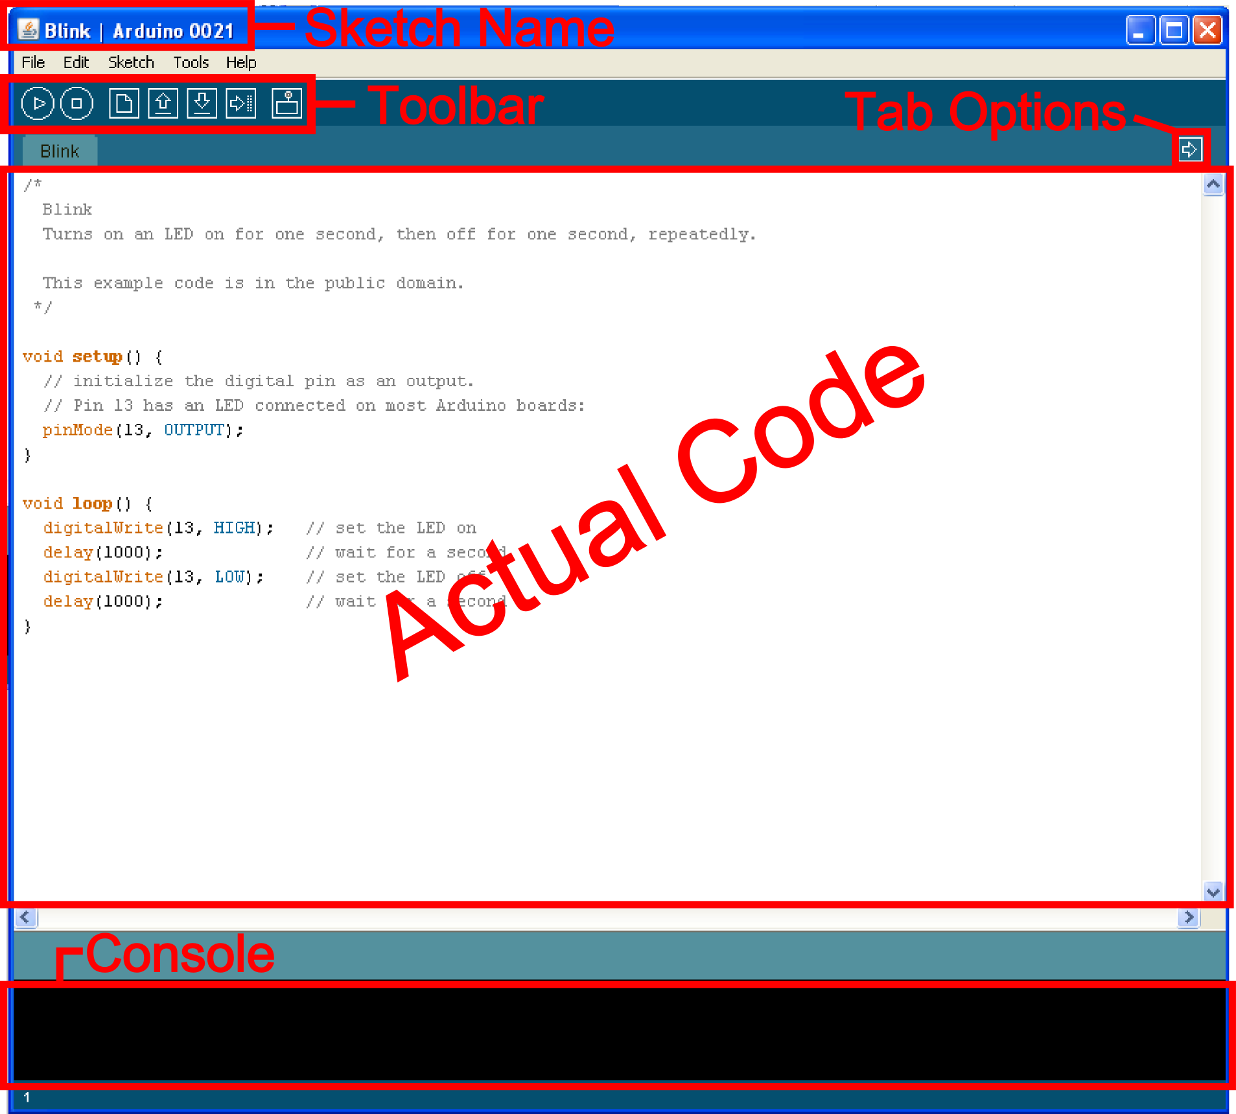
The Arduino Environment

Slide 2
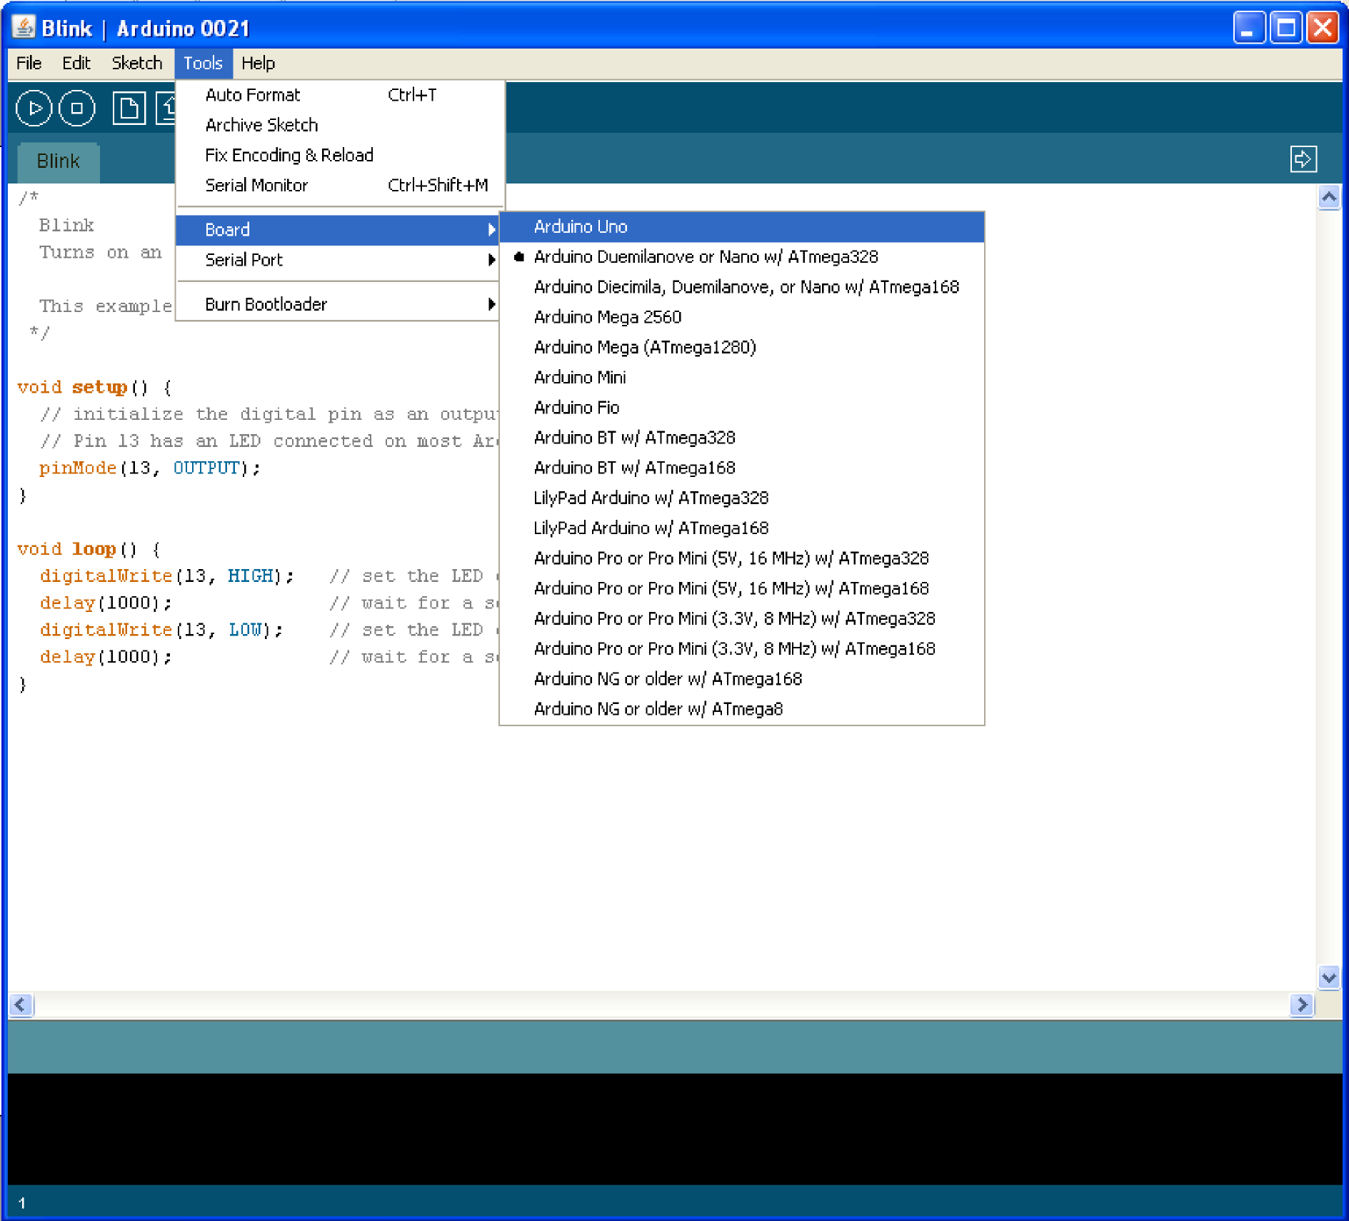
Board Type

Slide 3
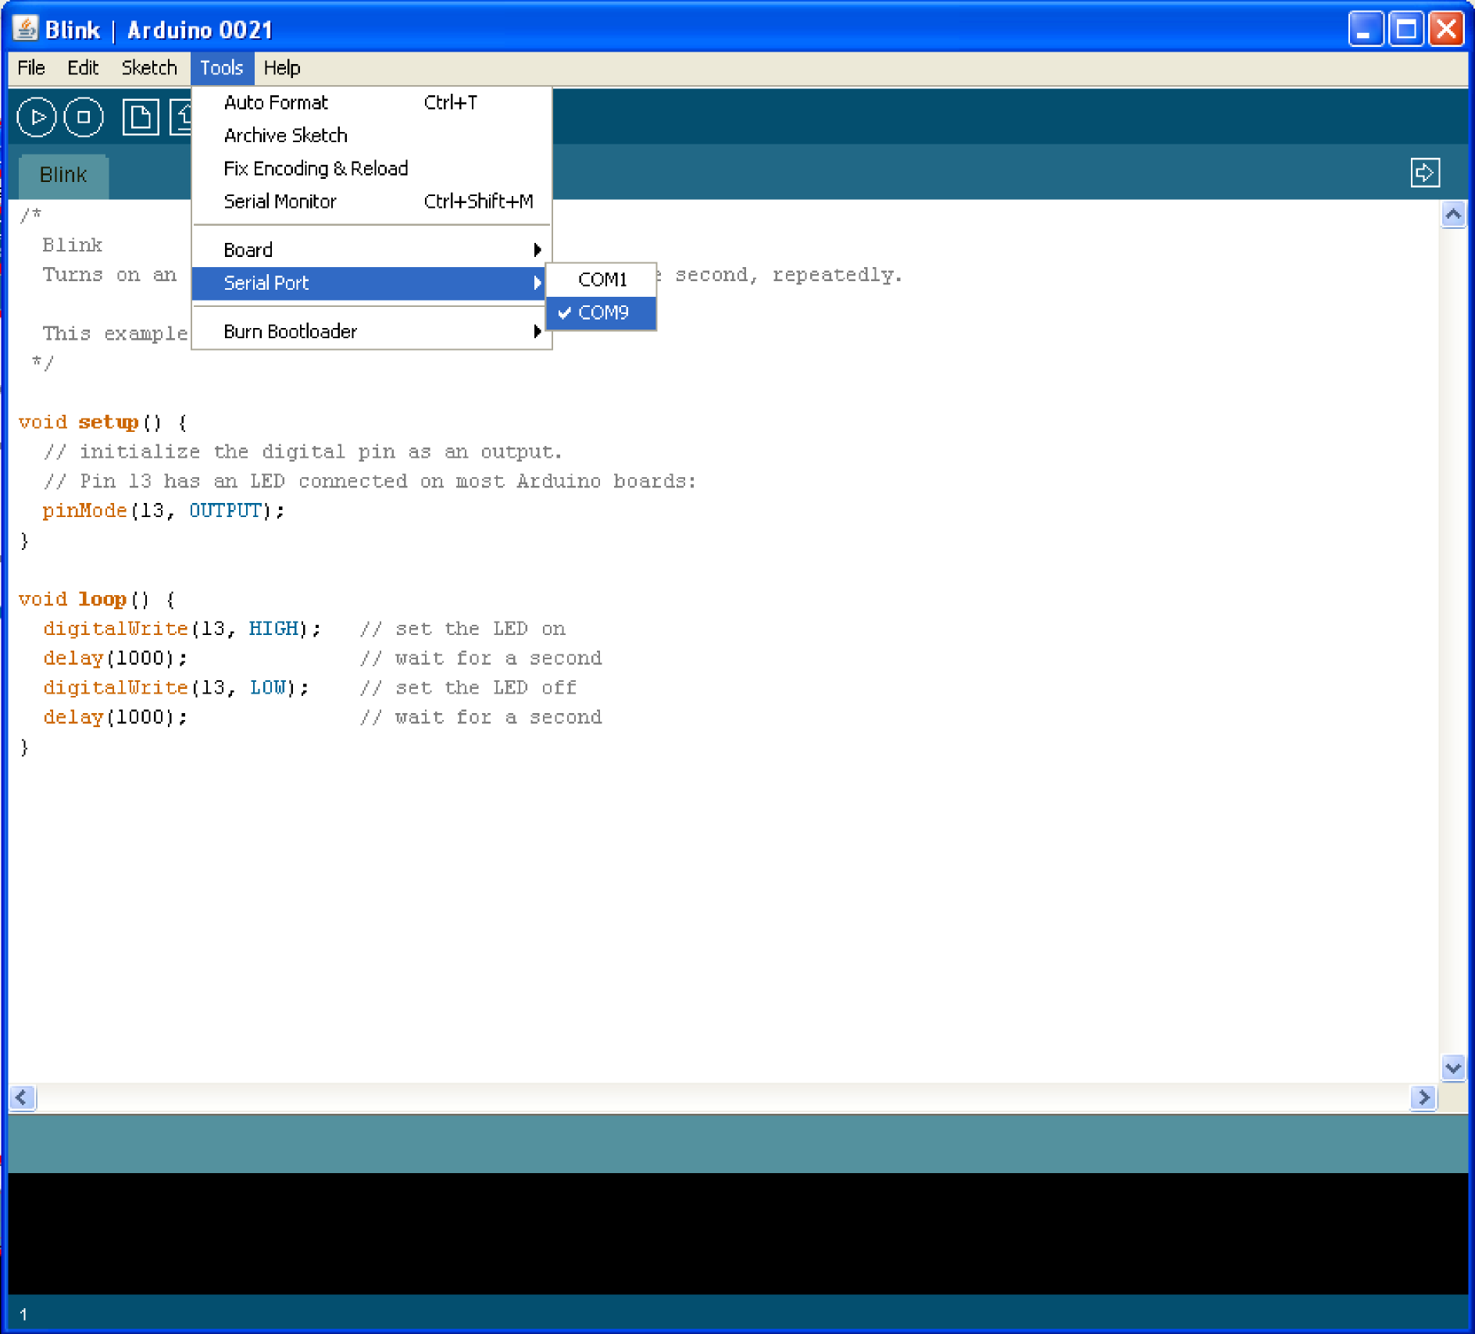
Serial Port / COM Port

Slide 4
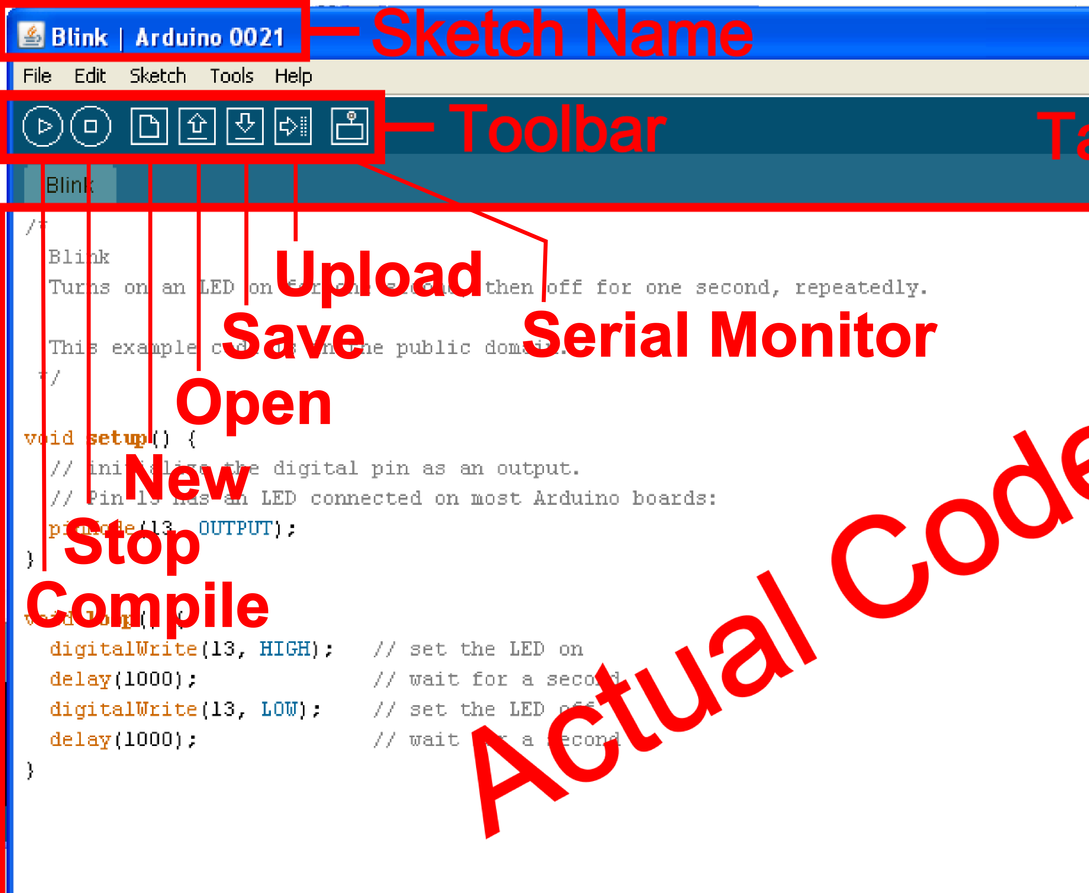
The Environment

Slide 5
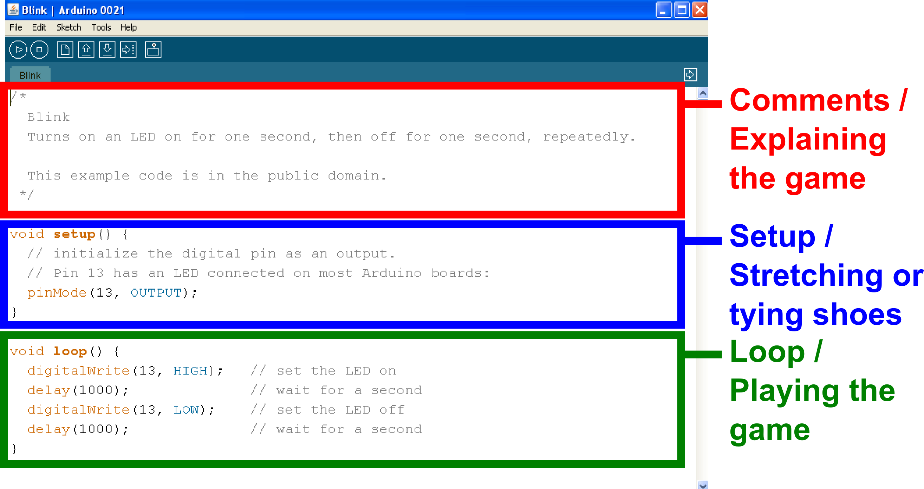
Parts of the Sketch

Slide 6
Comments
  Comments can be anywhere

Slide 7
Comments
  Comments can be anywhere
  Comments created with // or /* and */

Slide 8
Comments
  Comments can be anywhere
  Comments created with // or /* and */
  Comments do not affect code

Slide 9
Comments
  Comments can be anywhere
  Comments created with // or /* and */
  Comments do not affect code
  You may not need comments, but think about the community!

Slide 10
Operators
  The equals sign
  = is used to assign a value
  == is used to compare values

Slide 11
Operators
  And & Or
  && is “and”
  || is “or”

Slide 12
Variables
  Basic variable types:
  Boolean
  Integer
  Character

Slide 13
Declaring Variables
  Boolean: boolean variableName;

Slide 14
Declaring Variables
  Boolean: boolean variableName;
  Integer: int variableName;

Slide 15
Declaring Variables
  Boolean: boolean variableName;
  Integer: int variableName;
  Character: char variableName;

Slide 16
Declaring Variables
  Boolean: boolean variableName;
  Integer: int variableName;
  Character: char variableName;
  String: stringName [ ];

Slide 17
Assigning Variables
  Boolean: variableName = true;
  or variableName = false;

Slide 18
Assigning Variables
  Boolean: variableName = true;
  or variableName = false;
  Integer: variableName = 32767;
  or variableName = -32768;

Slide 19
Assigning Variables
  Boolean: variableName = true;
  or variableName = false;
  Integer: variableName = 32767;
  or variableName = -32768;
  Character: variableName = ‘A’;
  or stringName = “SparkFun”;

Slide 20
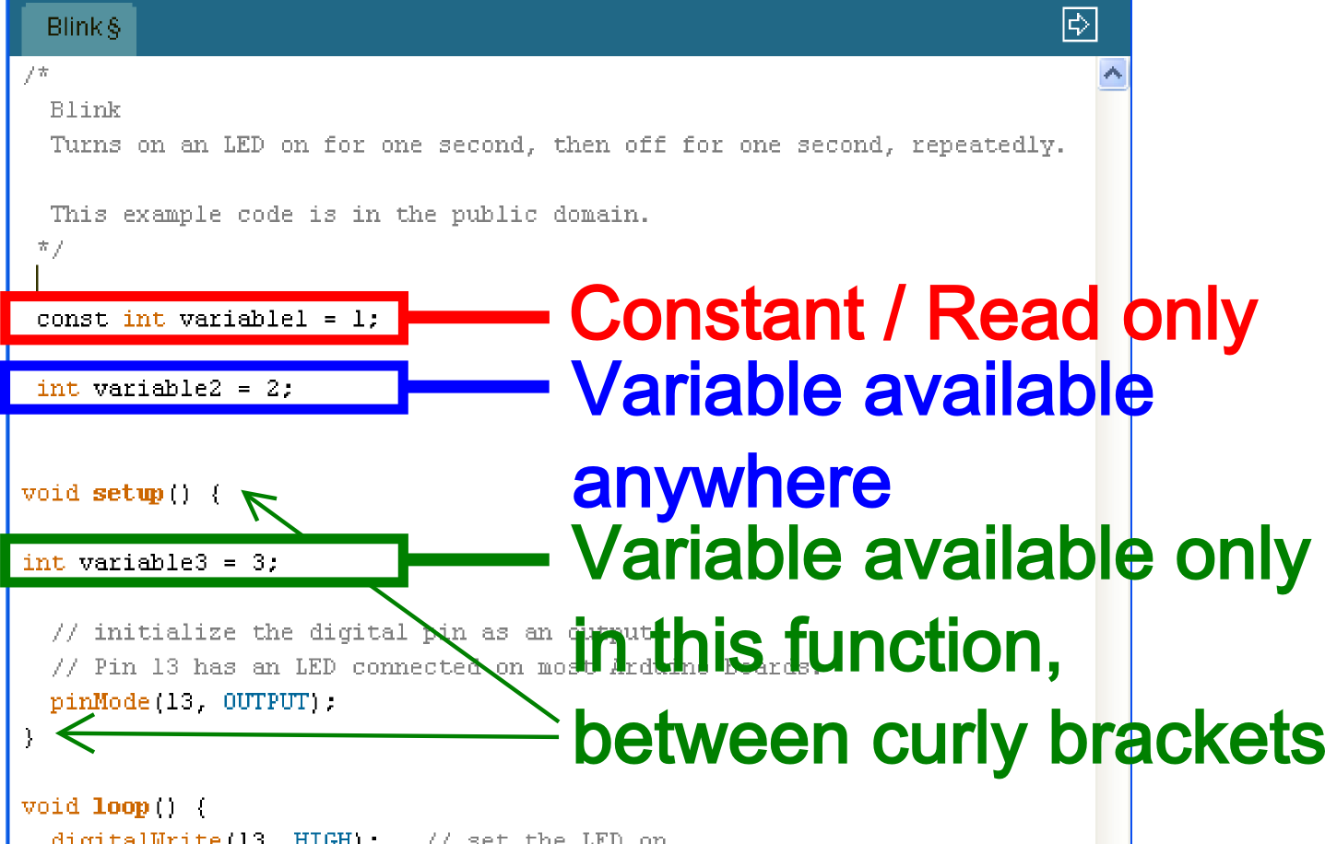
Variable Scope
Where you declare your variables matters

Slide 21
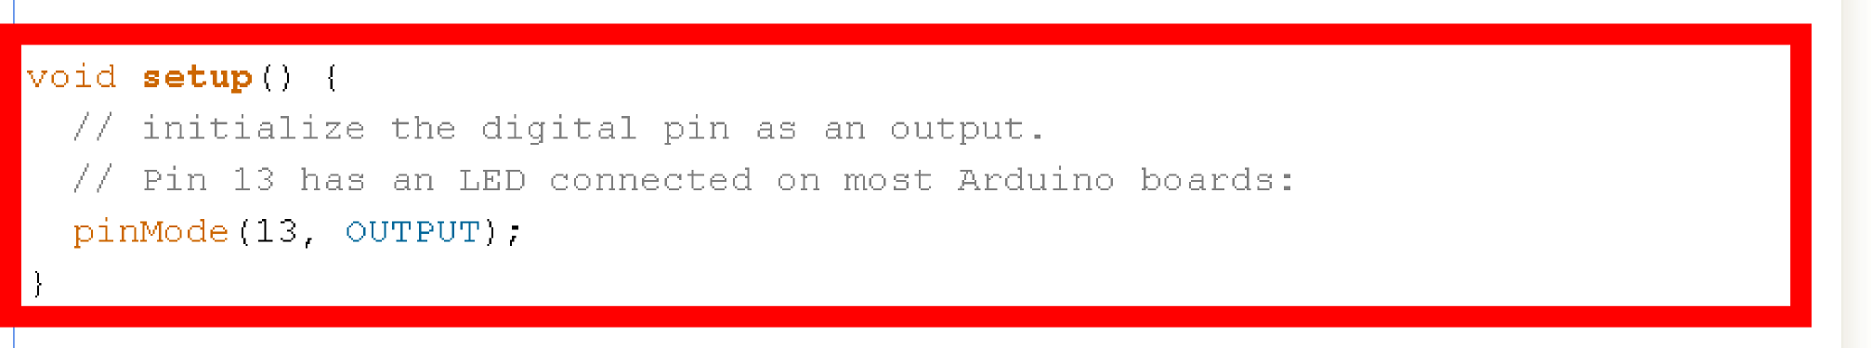
Setup void setup ( ) { }
The setup function comes before
the loop function and is necessary
for all Arduino sketches

Slide 22
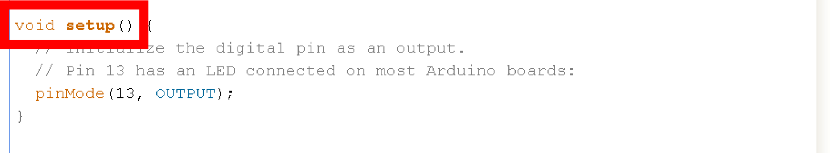
Setup void setup ( ) { }
The setup header will never change,
everything else that occurs in setup
happens inside the curly brackets

Slide 23
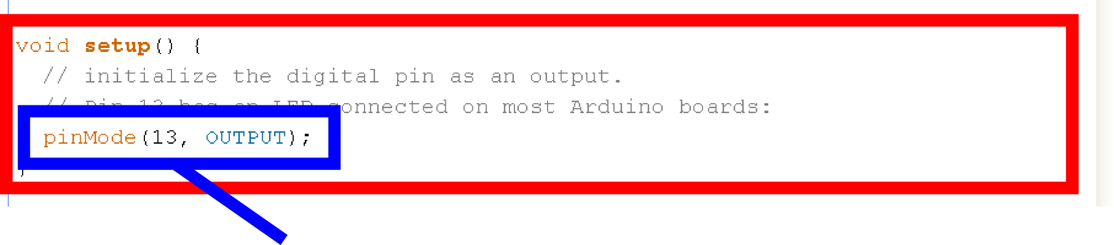
Setup void setup ( ) { pinMode (13, OUTPUT); }
Outputs are declare in setup, this is done by using the pinMode function
This particular example declares digital pin # 13 as an output, remember to use CAPS

Slide 24
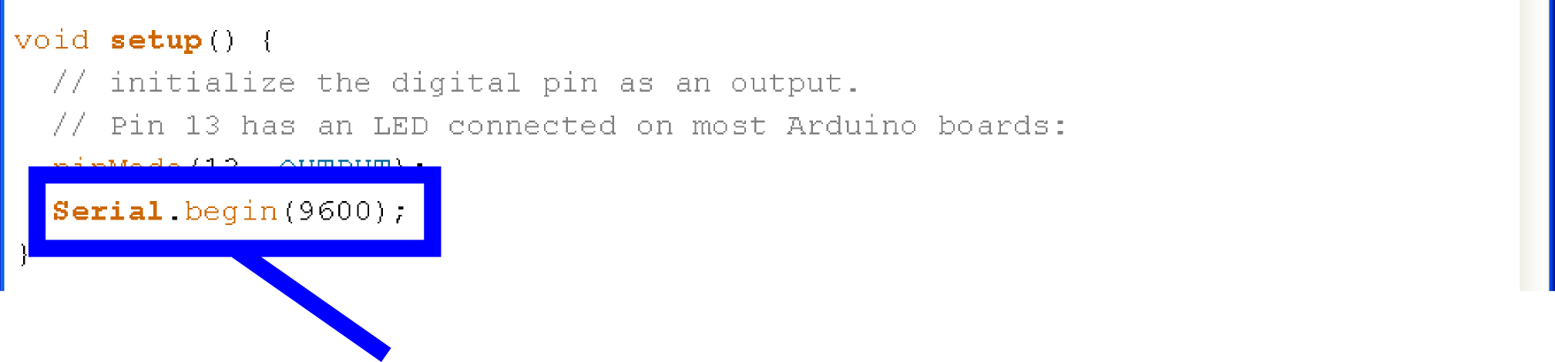
Setup void setup ( ) { Serial.begin;}
Serial communication also begins in setup
This particular example declares Serial communication at a baud rate of 9600. More on Serial later...

Slide 25
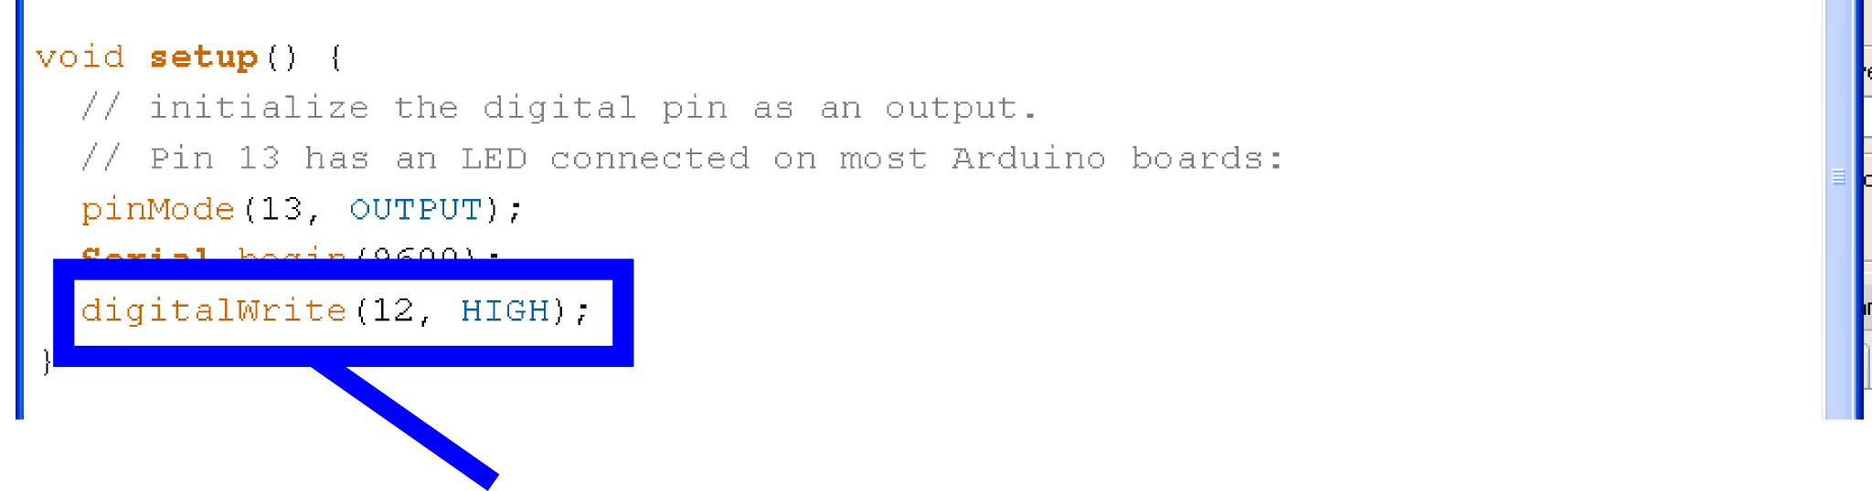
Setup, Internal Pullup Resistors void setup ( ) { digitalWrite (12, HIGH); }
You can also create internal pullup resistors in setup, to do so digitalWrite the pin HIGH
This takes the place of the pullup resistors currently on your circuit 7 buttons

Slide 26
Setup, Interrupts void setup ( ) { attachInterrupt (interrupt, function, mode) }
  You can designate an interrupt function to Arduino pins # 2 and 3
  This is a way around the linear processing of Arduino

Slide 27
Setup, Interrupts void setup ( ) { attachInterrupt (interrupt, function, mode) }
  Interrupt: the number of the interrupt, 0 or 1, corresponding to Arduino pins # 2 and 3 respectively
  Function: the function to call when the interrupt occurs
  Mode: defines when the interrupt should be triggered

Slide 28
Setup, Interrupts void setup ( ) { attachInterrupt (interrupt, function, mode) }
  LOW whenever pin state is low
  CHANGE whenever pin changes value
  RISING whenever pin goes from low to high
  FALLING whenever pin goes from low to high
  Don’t forget to CAPITALIZE

Slide 29
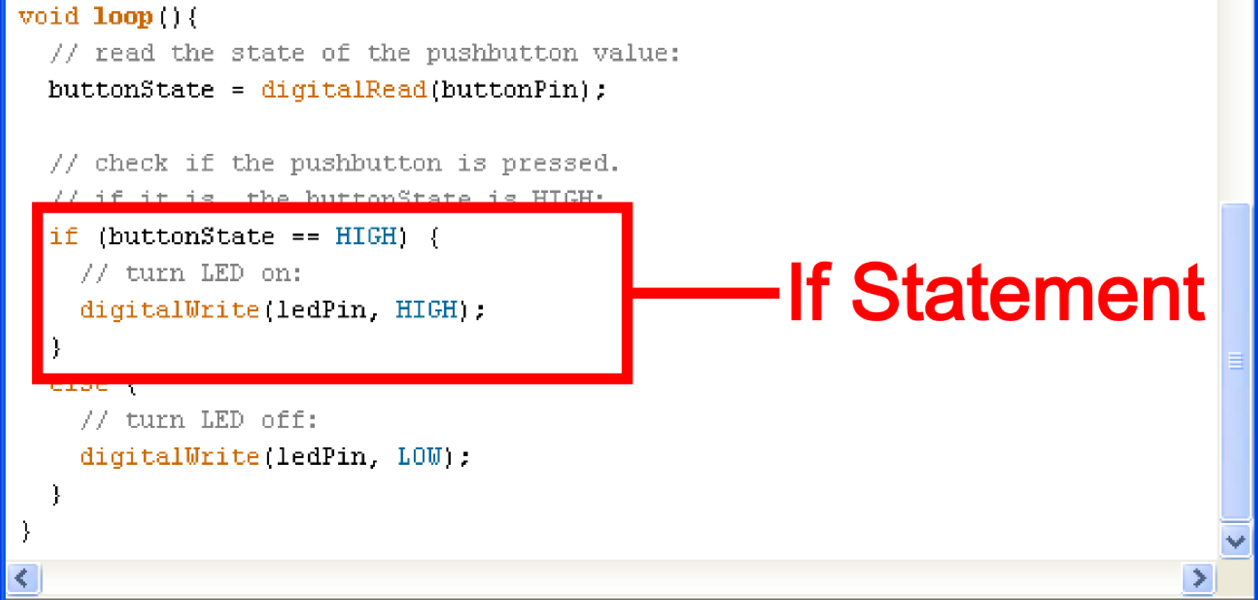
If Statements
if ( this is true ) { do this; }

Slide 30
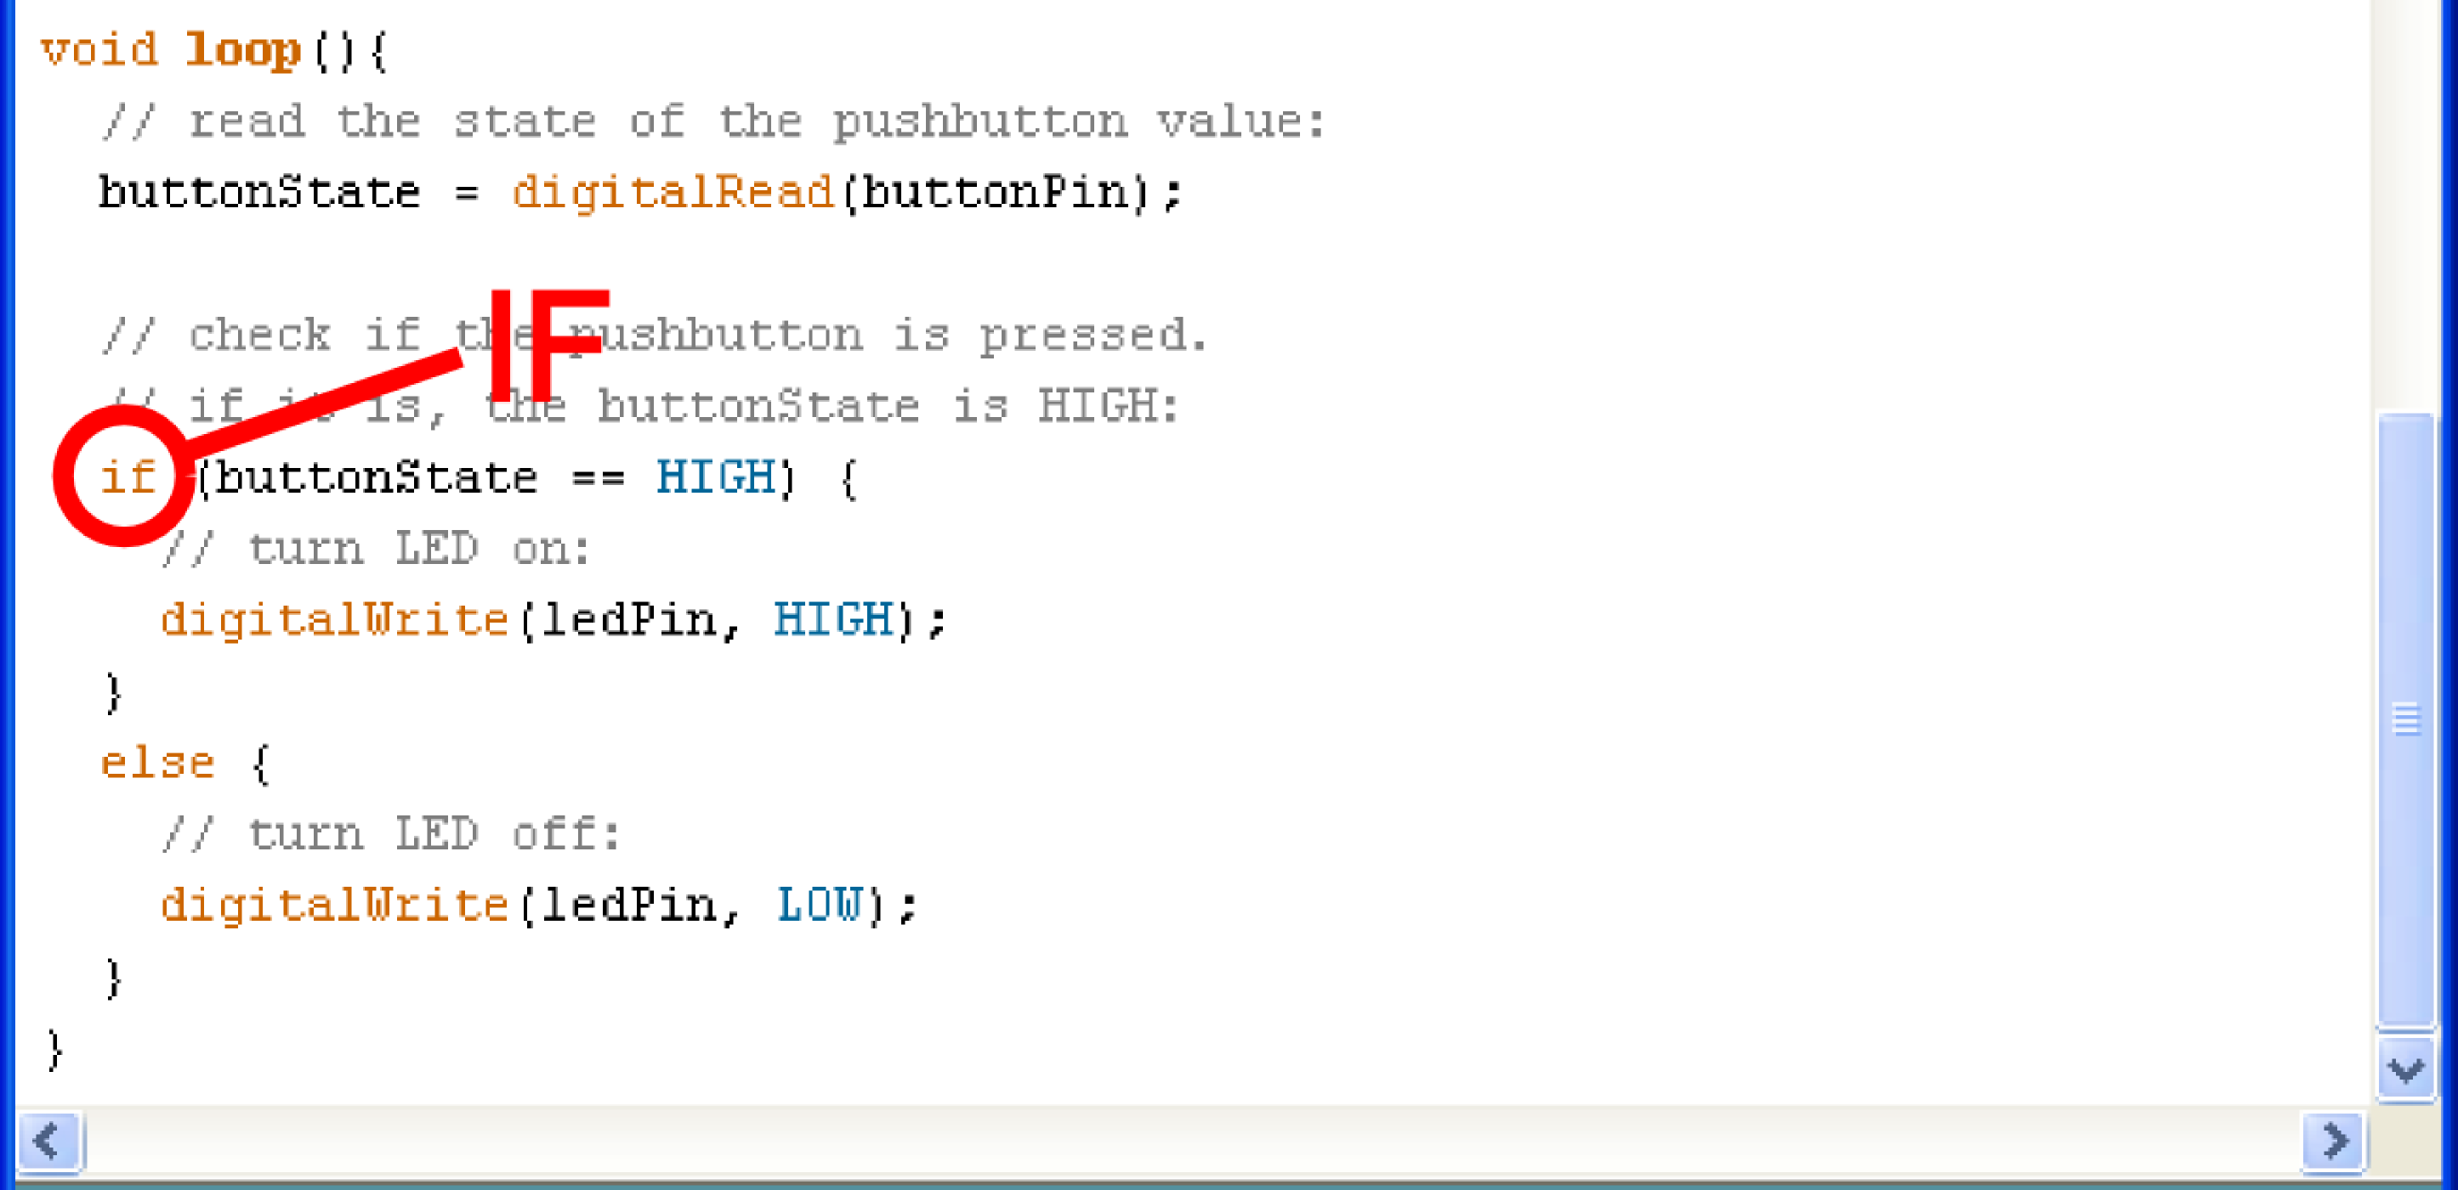
If
if ( this is true ) { do this; }

Slide 31
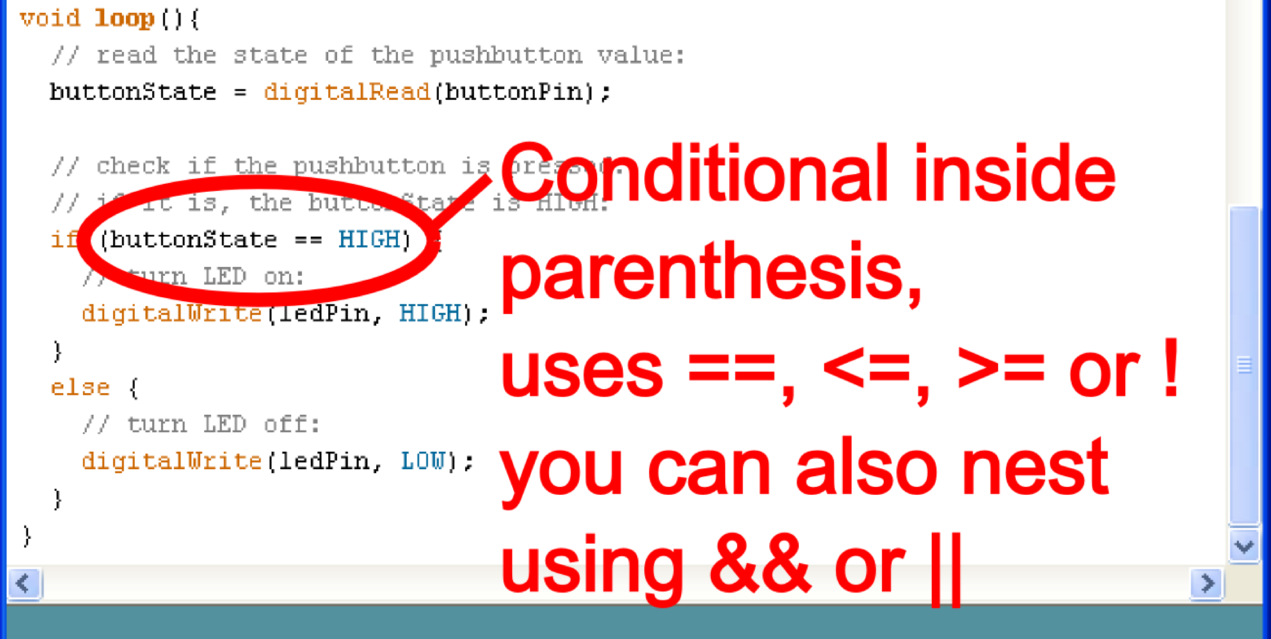
Conditional
if ( this is true ) { do this; }

Slide 32
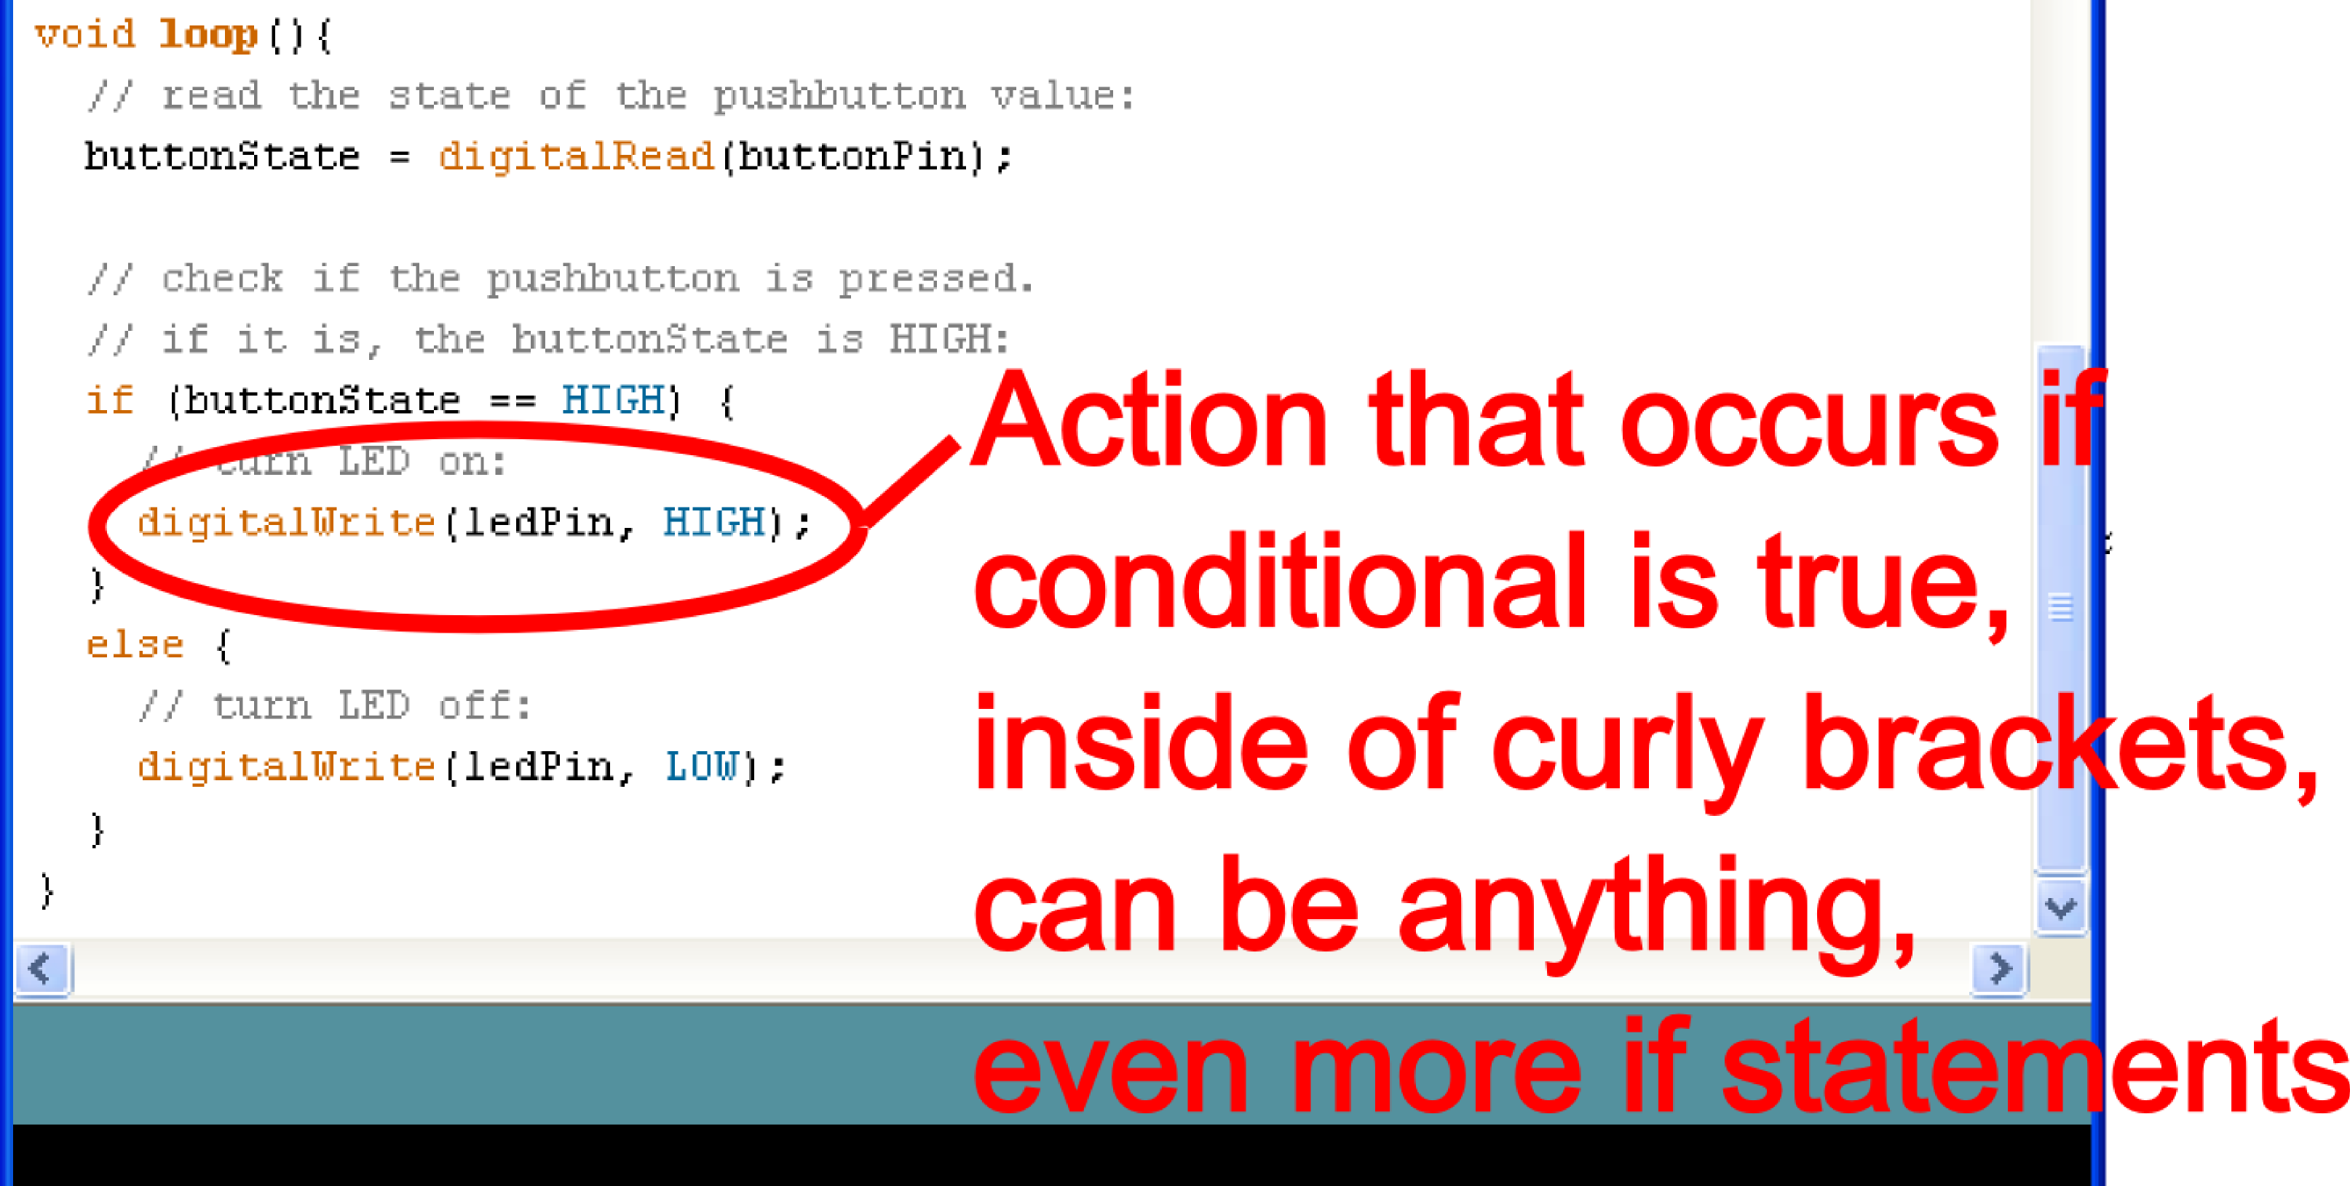
Action
if ( this is true ) { do this; }

Slide 33
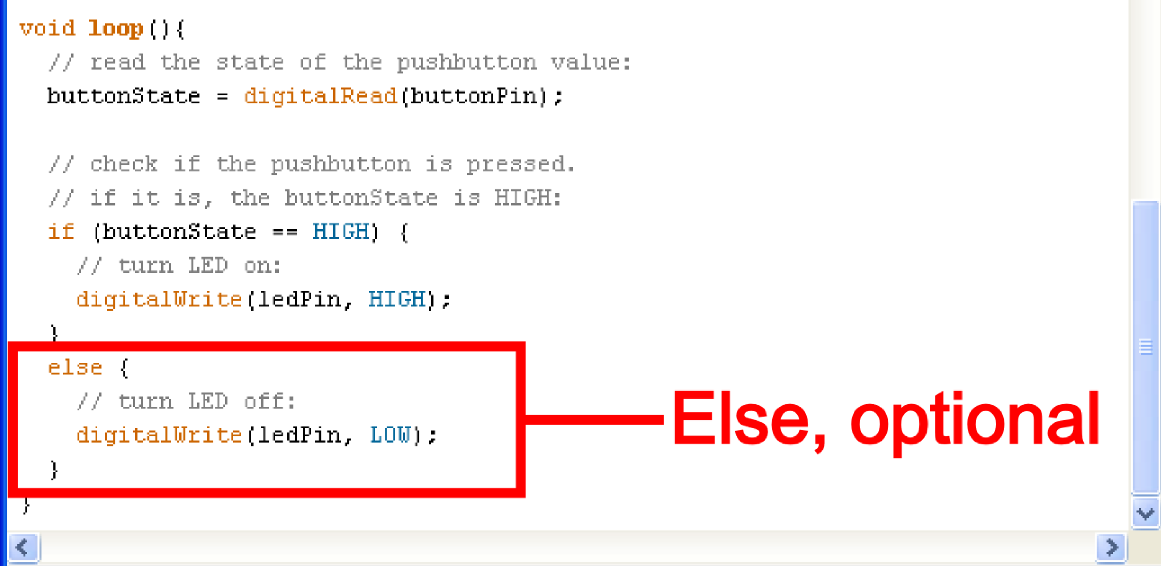
Else
else { do this; }

Slide 34
Basic Repetition
loop
For
while

Slide 35
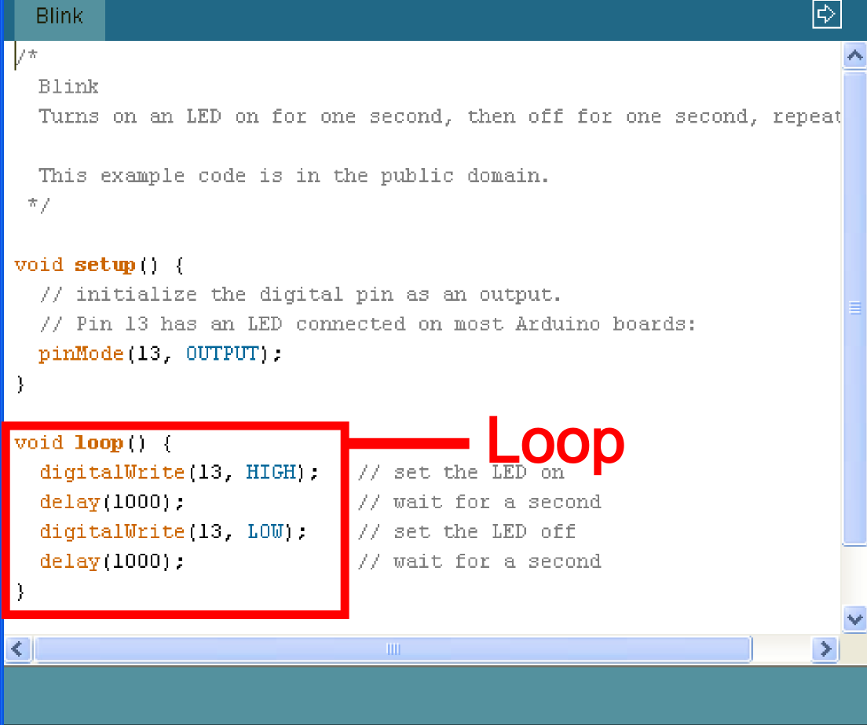
Basic Repetition
void loop ( ) { }

Slide 36
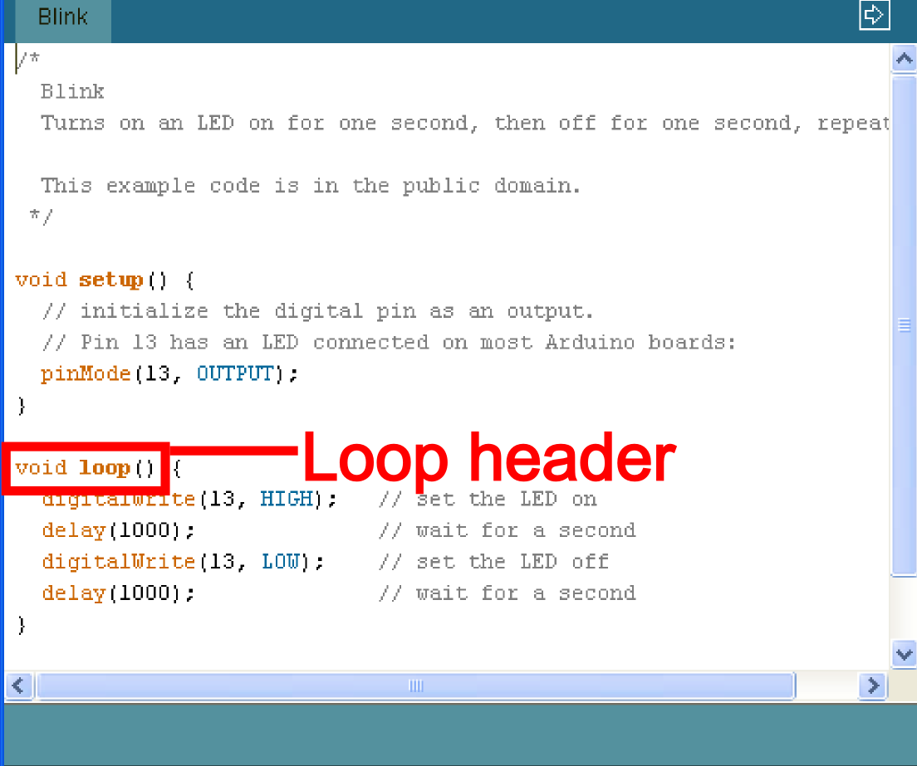
Basic Repetition
void loop ( ) { }

Slide 37
Basic Repetition
void loop ( ) { }
The “void” in the header is what the function will return (or spit out) when it happens, in this case it returns nothing so it is void

Slide 38
Basic Repetition
void loop ( ) { }
The “loop” in the header is what the function is called, sometimes you make the name up, sometimes (like loop) the function already has a name

Slide 39
Basic Repetition
void loop ( ) { }
The “( )” in the header is where you declare any variables that you are “passing” (or sending) the function, the loop function is never “passed” any variables

Slide 40
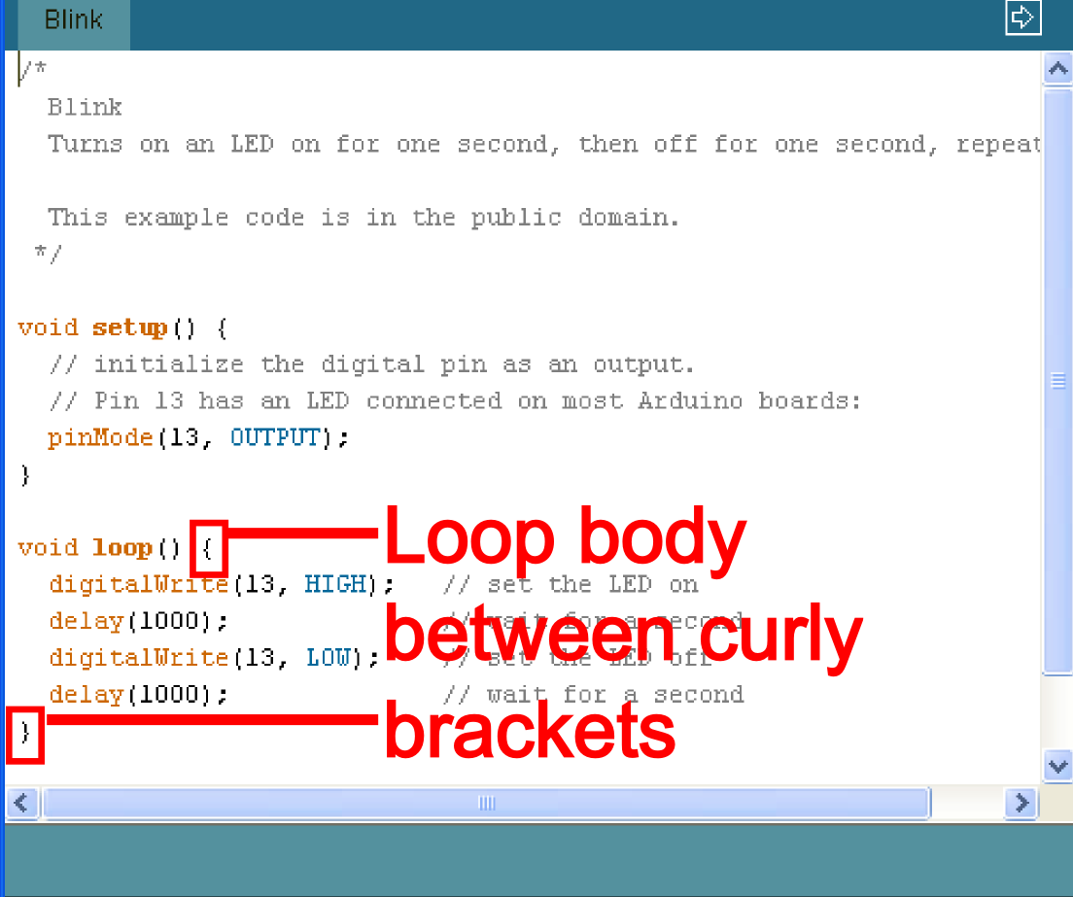
Basic Repetition
void loop ( ) { }

Slide 41
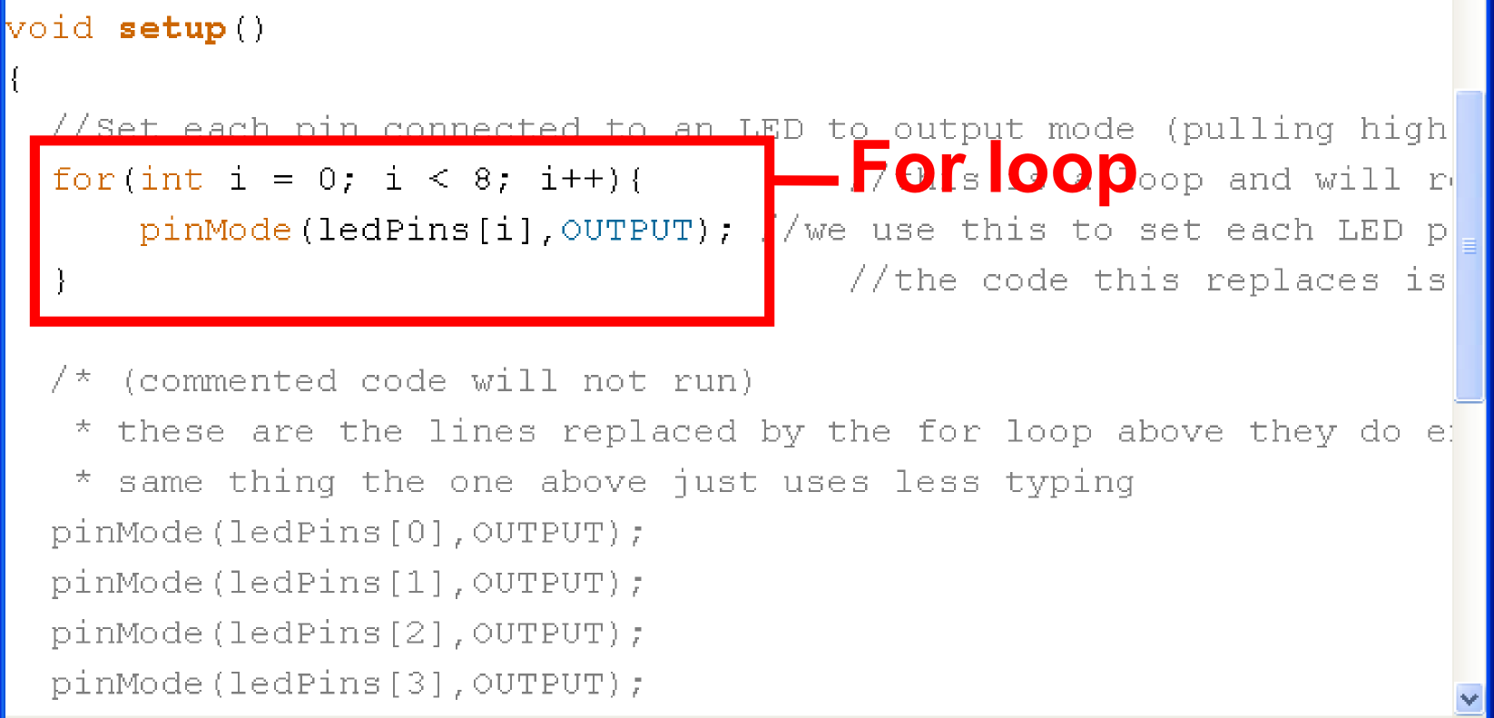
Basic Repetition
for (int count = 0; count<10; count++)
{
//for action code goes here
//this could be anything
}

Slide 42
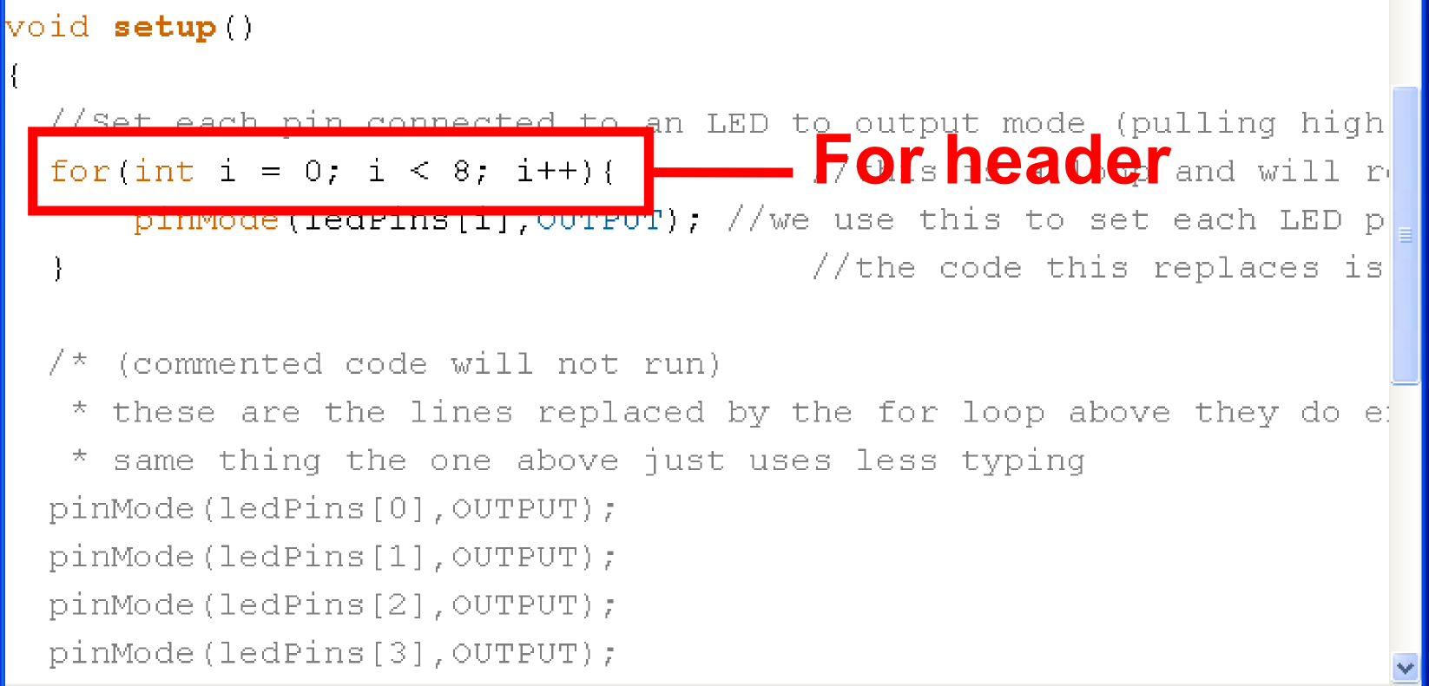
Basic Repetition
for (int count = 0; count<10; count++)
{
//for action code goes here
}

Slide 43
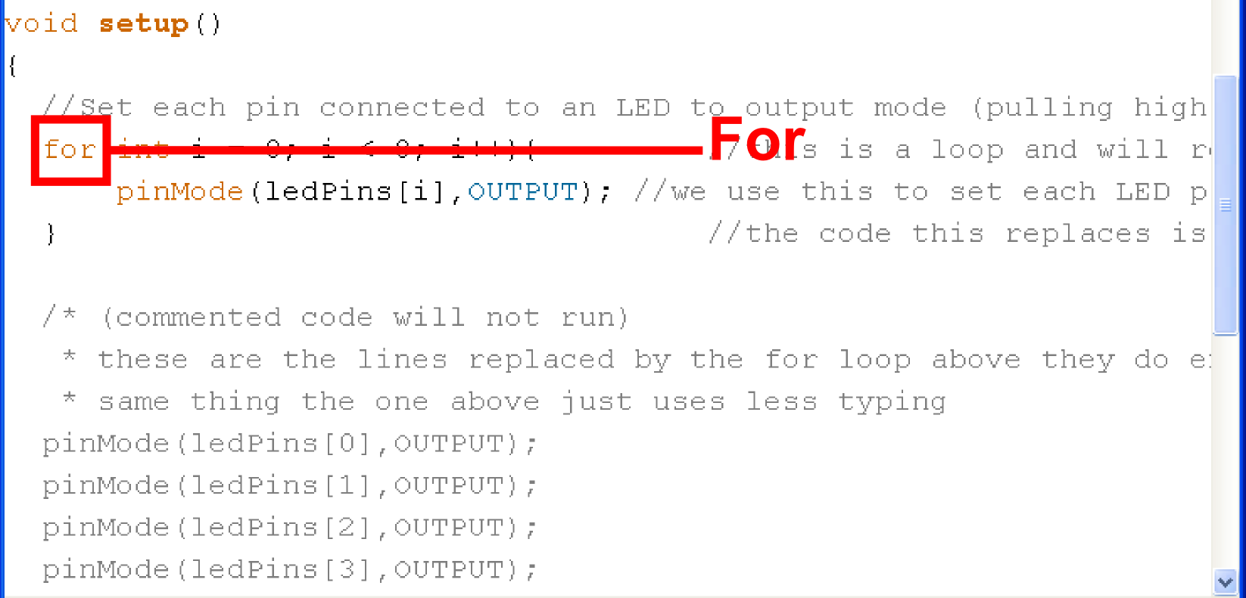
Basic Repetition
for (int count = 0; count<10; count++)
{
//for action code goes here
}

Slide 44
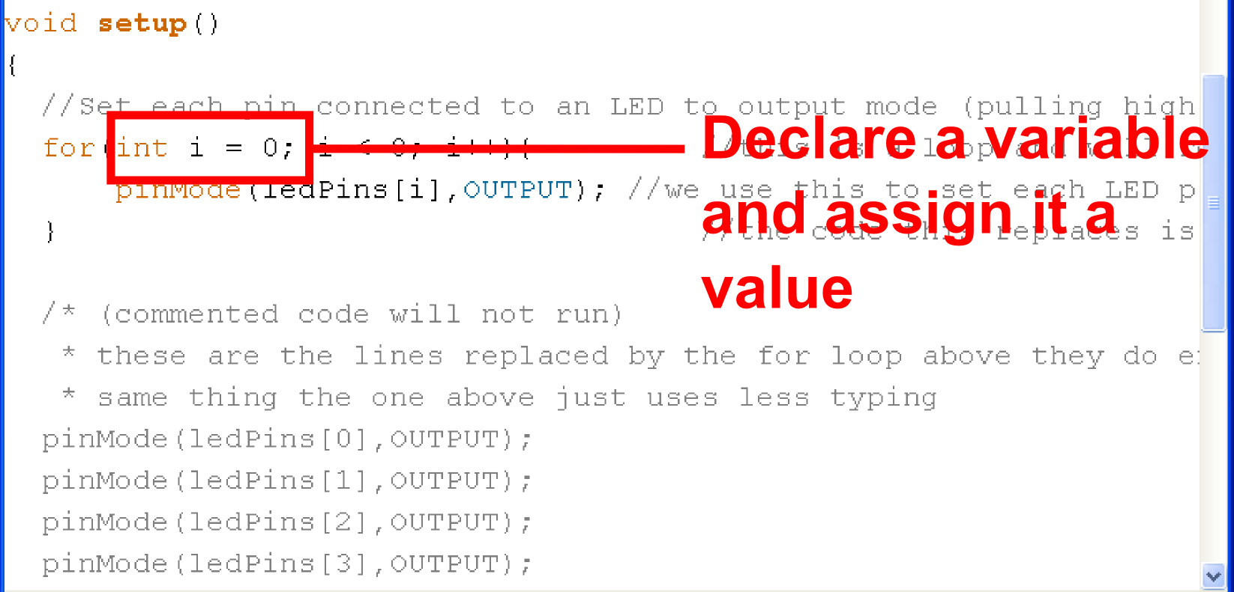
Basic Repetition
for (int count = 0; count<10; count++)
{
//for action code goes here
}

Slide 45
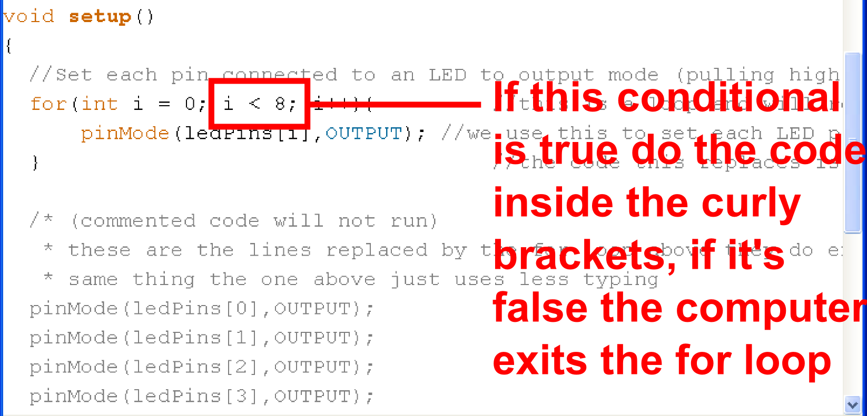
Basic Repetition
for (int count = 0; count<10; count++)
{
//for action code goes here
}

Slide 46
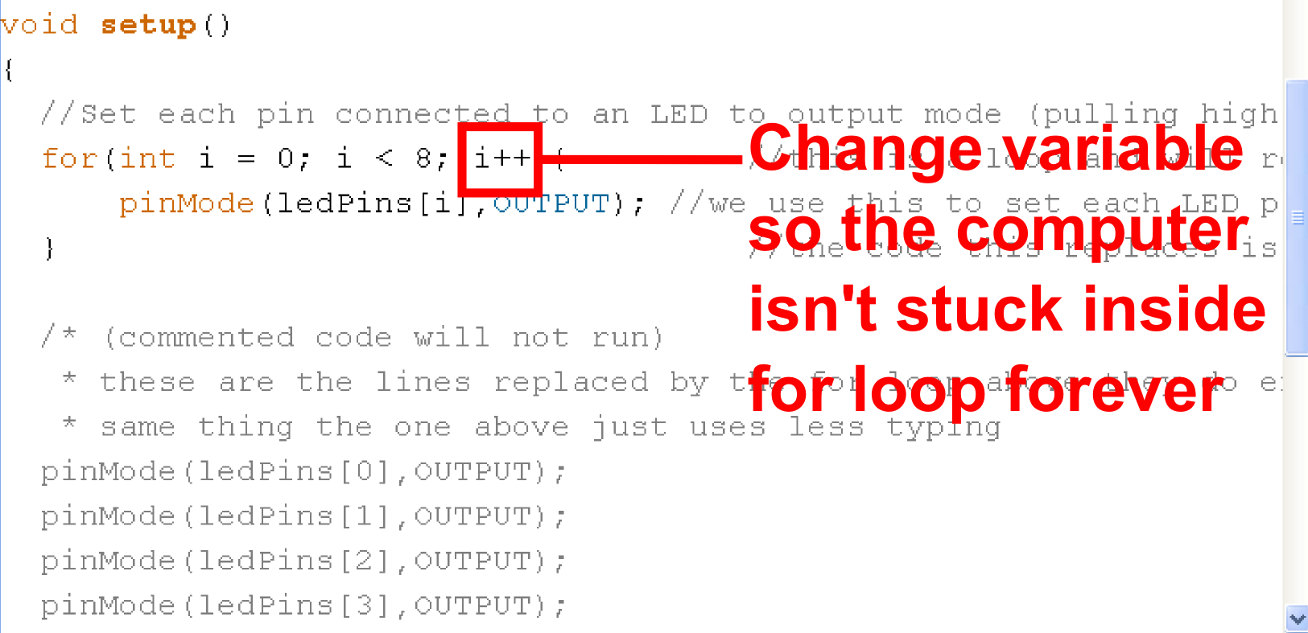
Basic Repetition
for (int count = 0; count<10; count++)
{
//for action code goes here
}

Slide 47
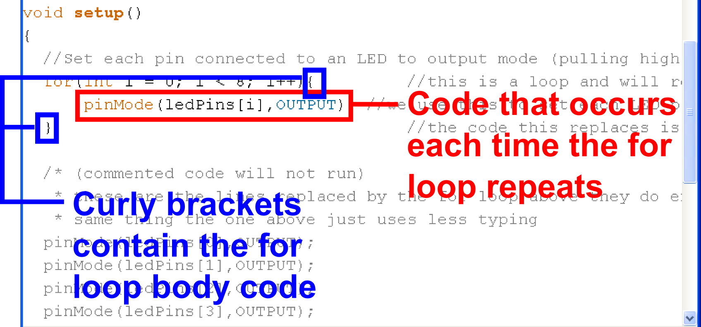
Basic Repetition
for (int count = 0; count<10; count++)
{
//for action code goes here
}

Slide 48
Basic Repetition
while ( count<10 )
{
//while action code goes here
}

Slide 49
Basic Repetition
while ( count<10 )
{
//while action code goes here
//should include a way to change count
//variable so the computer is not stuck
//inside the while loop forever
}

Slide 50
Basic Repetition
while ( count<10 )
{
//looks basically like a “for” loop
//except the variable is declared before
//and incremented inside the while
//loop
}

Slide 51
Basic Repetition
Or maybe:
while ( digitalRead(buttonPin)==1 )
{
//instead of changing a variable
//you just read a pin so the computer
//exits when you press a button
//or a sensor is tripped
}

